Slide 1


San Francisco International Airport
Strategic Plan 2023-2028
Notes:
It’s my pleasure to present SFO’s new 5-Year Strategic Plan.
Developed through an inclusive and collaborative staff engagement process, the new Strategic Plan is a testament to SFO’s resilience, renewed sense of purpose, and aspirations for the future.

Slide 2
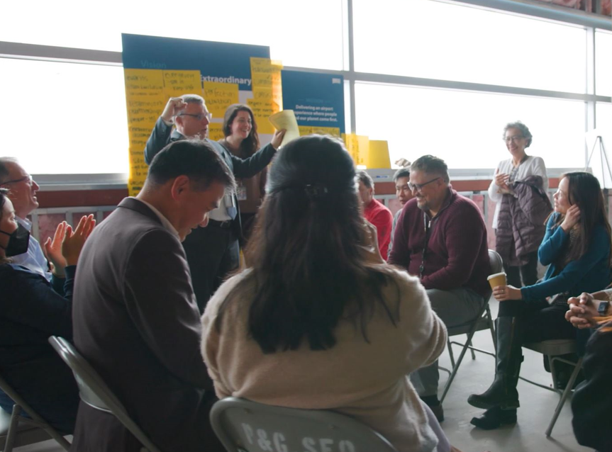
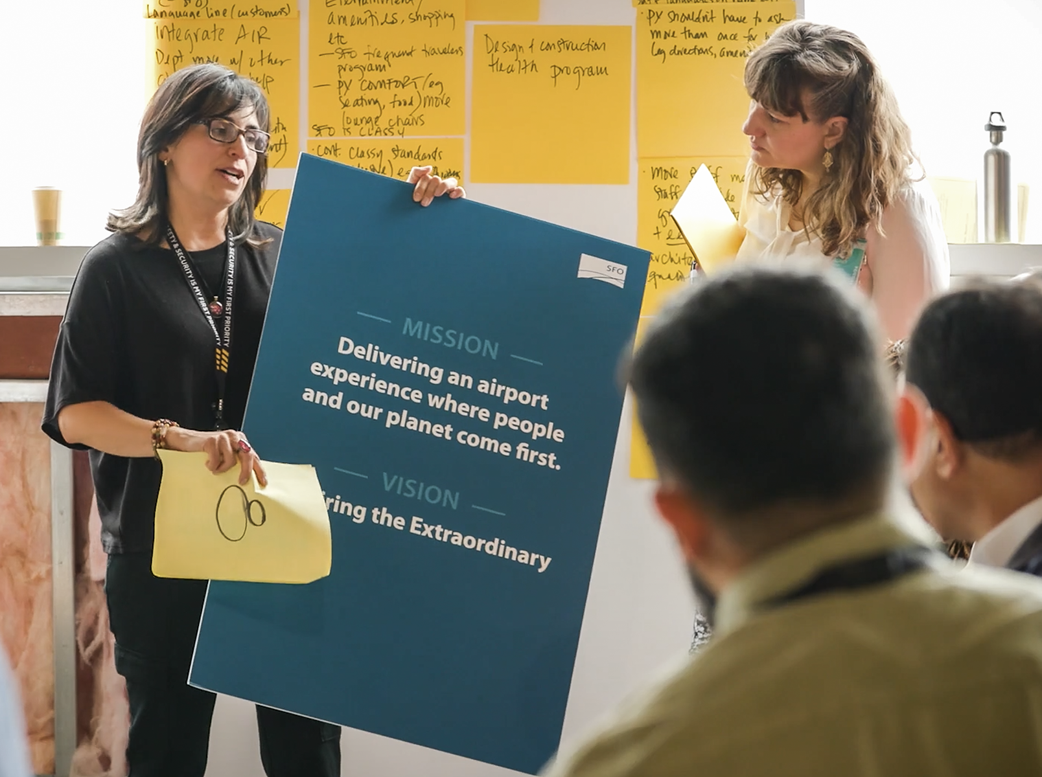
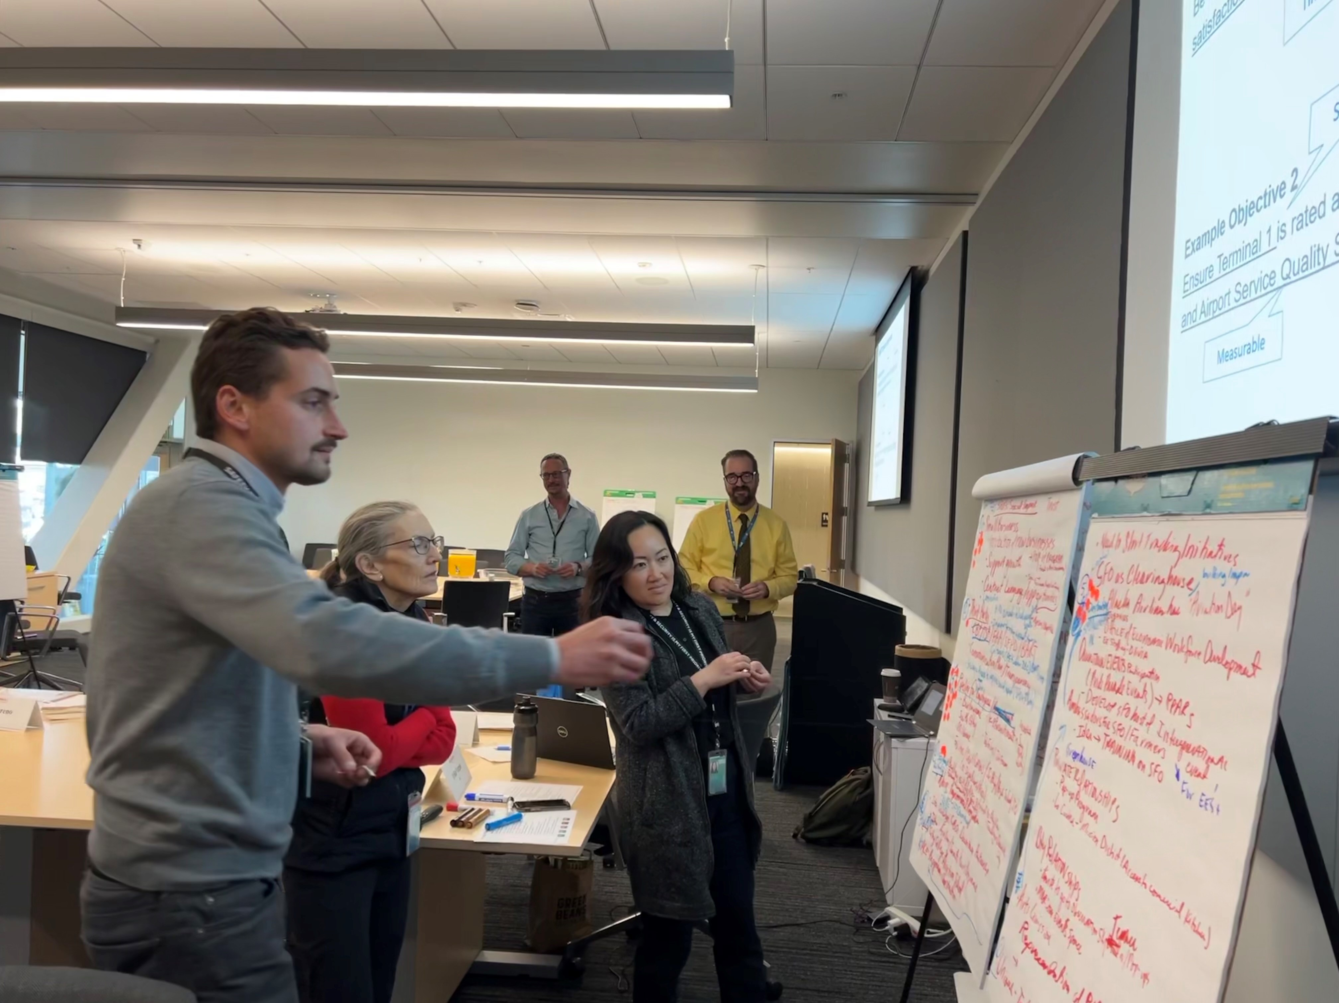
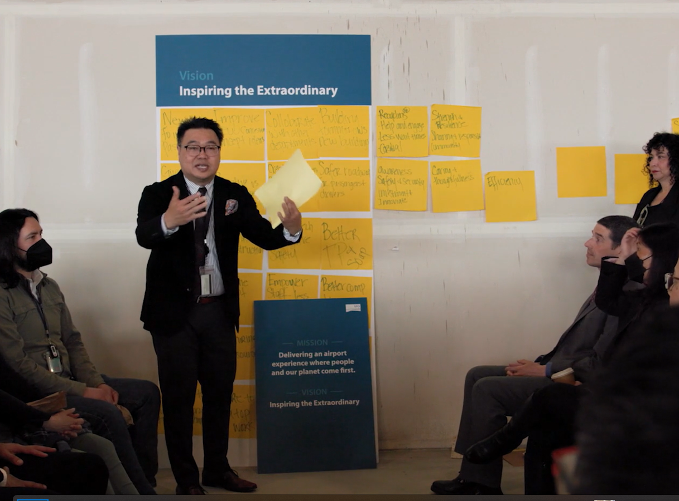
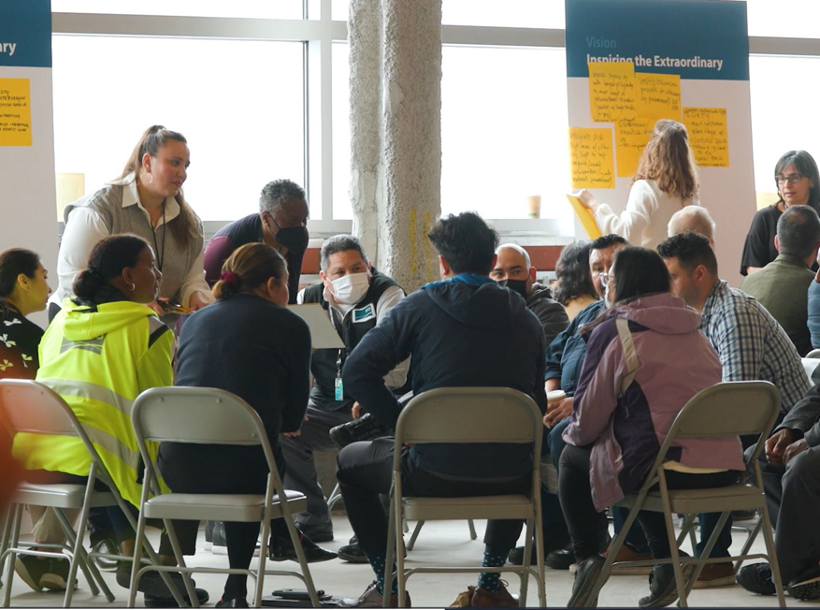
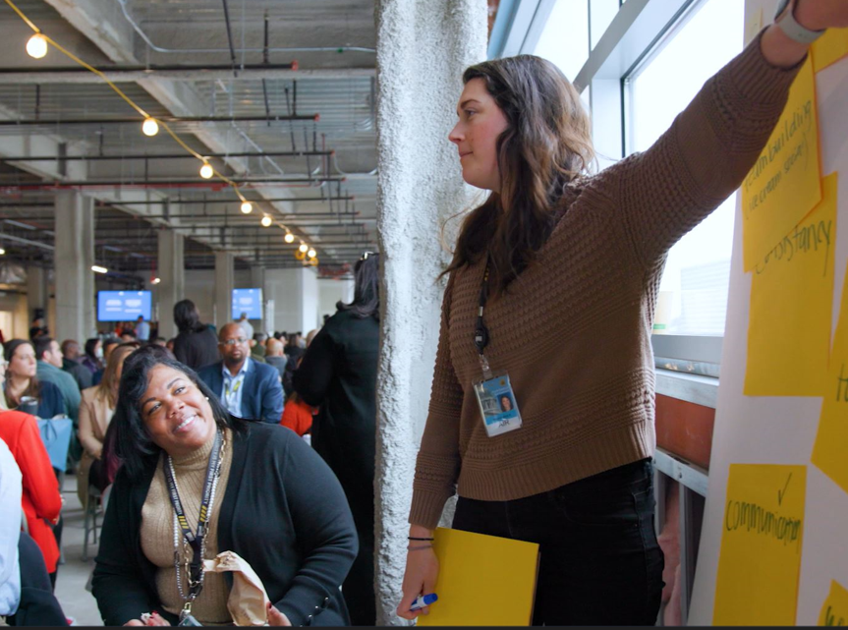
GLIMPSE INTO THE EXTRAORDINARY
25% Staff Participation
2
Notes:
The new Strategic Plan was developed through an inclusive and collaborative engagement process in which 25% of SFO Staff, representing every section and level of the organization, actively participated.

Slide 3
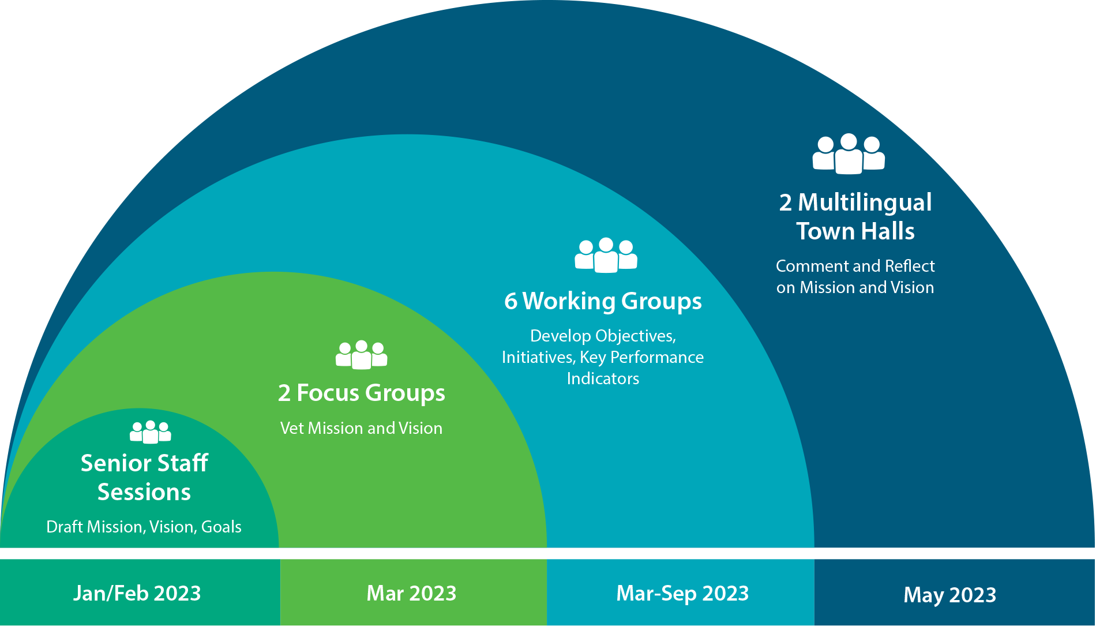
HOW WE GOT HERE
Staff Engagement Process
Notes:
The process began in early 2023 with the Senior Leadership team and then expanded by encouraging the participation of team members across the Airport.
In March, we held focus groups with leaders from the Racial Equity Committee, Employee Resource Groups, and R4N1 Committee to obtain feedback on the draft mission and vision statements.
As a result of their honest and open feedback, we revised the statements to make them better and stronger.
At the same time, in March, we launched five working groups led by Senior Staff to fully define the strategic goals by developing the objectives, initiatives, and metrics. And in August, we launched a sixth working group when we elevated Safety and Security to be a standalone goal.
The working groups were formed by inviting staff to volunteer and assigning them to the strategic goal most aligned with their interest.
Over 100 staff members who reflected the diversity of backgrounds and perspectives participated.
The staff engagement process culminated in May with SFO’s first-ever multilingual town halls.
The purpose of the town hall was to ask staff to comment on the mission and vision and to reflect on how the statements applied to their work.
The town halls had simultaneous interpretation in Cantonese, Spanish, and Filipino and small in-language break-out groups.
Now, on to a brief overview of the six new goals.

Slide 4
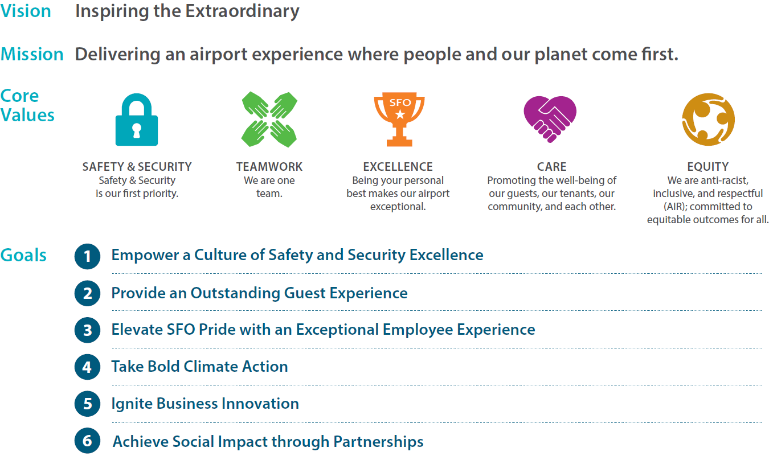
SUMMARY
4
Supported by 26 Objectives and 90 initiatives
Notes:
Presented on this first slide are the high-level elements – the Vision, Mission, and Goals.
At the center of the plan are the mission and vision statements.
The vision, “Inspiring the Extraordinary,” is about a future where SFO sets new standards and achieves bold new heights not only for our benefit but to inspire change within our industry and to better our world.
The mission, "Delivering an airport experience where people and our planet come first," centers our purpose and everyday focus on people and our planet.
At the core of everything we do lies a deep commitment to the well-being of our guests, employees, tenants, and the communities we serve.
Likewise, environmental stewardship is our compass, guiding our decisions across our operations and projects.
The Strategic Plan also encompasses SFO’s Core Values of Safety & Security, Teamwork, Excellence, Care, and Equity.
They exemplify SFO’s culture, embodying how we work together, what we stand for, and guiding our decisions.
Staff performance appraisals include our core competencies which are focused on the Core Values, and training is offered to support ongoing development in those areas.
In addition, the annual Employee Recognition Awards honors team members whose work and contributions have supported the Core Values in an exceptional way.
The Core Values are foundational to who we are and are integral to the roadmap to the future established by the new 5-Year Strategic Plan.
Next, I will give a very brief overview of the 6 Strategic Plan goals.
To fulfill our mission and achieve our vision, we have developed six strategic goals to guide our efforts over the next five years.

Slide 5
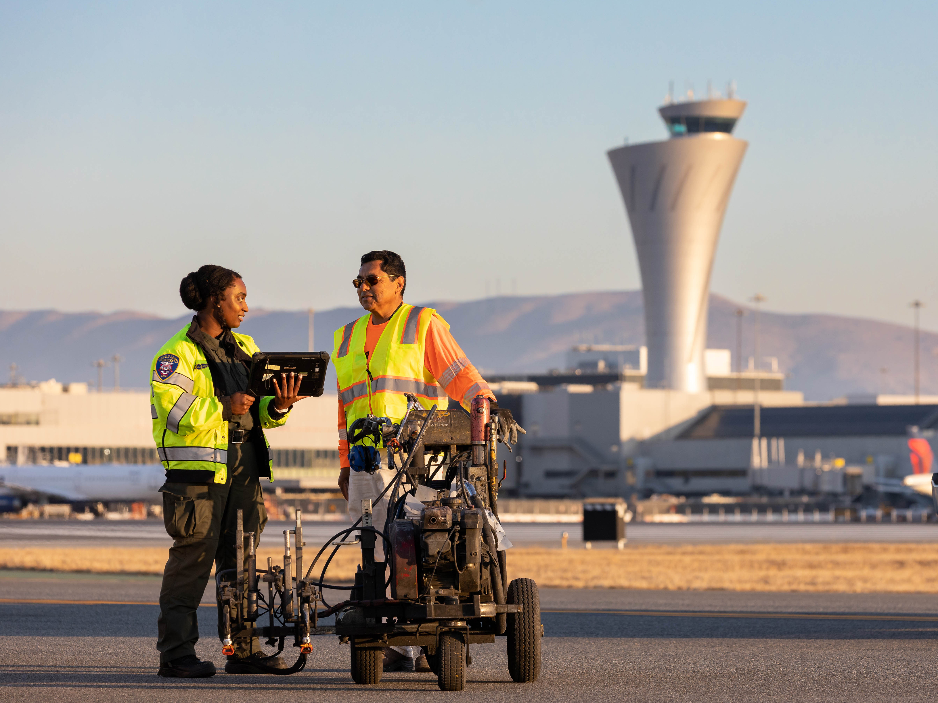
Empower a Culture of Safety
and Security Excellence
1
5
Notes:
Goal 1, “Empower a Culture of Safety and Security Excellence.”

Slide 6
Empower a Culture of Safety
and Security Excellence
1.1 Cultivate a collective sense of pride, ownership, and advocacy for safety and security by prioritizing education, training, and facilitating open and accessible communication.
1.2 Enhance SFO’s security posture through strategic investment in assets, infrastructure, and technology.
1.3 Advance safety systems and implement comprehensive measures that prioritize the airport community.
1.4 Create a comprehensive, research-driven framework to foster a healthy, thriving environment for our workforce and guests.
Supported by 15 initiatives
6
Notes:
With a focus on culture, our goal is to cultivate pride, accountability, and ownership for safety and security across all airport operations.
The objectives will further enhance Safety and Security by prioritizing education and training, investments in assets, infrastructure, and technology, the advancement of safety systems, and the creation of a comprehensive framework to foster a healthy and thriving environment.
As we envision the next five years, we aspire for each member of our community to have the knowledge and resources to assume a pivotal role in protecting one another and upholding a collective sense of care.

Slide 7
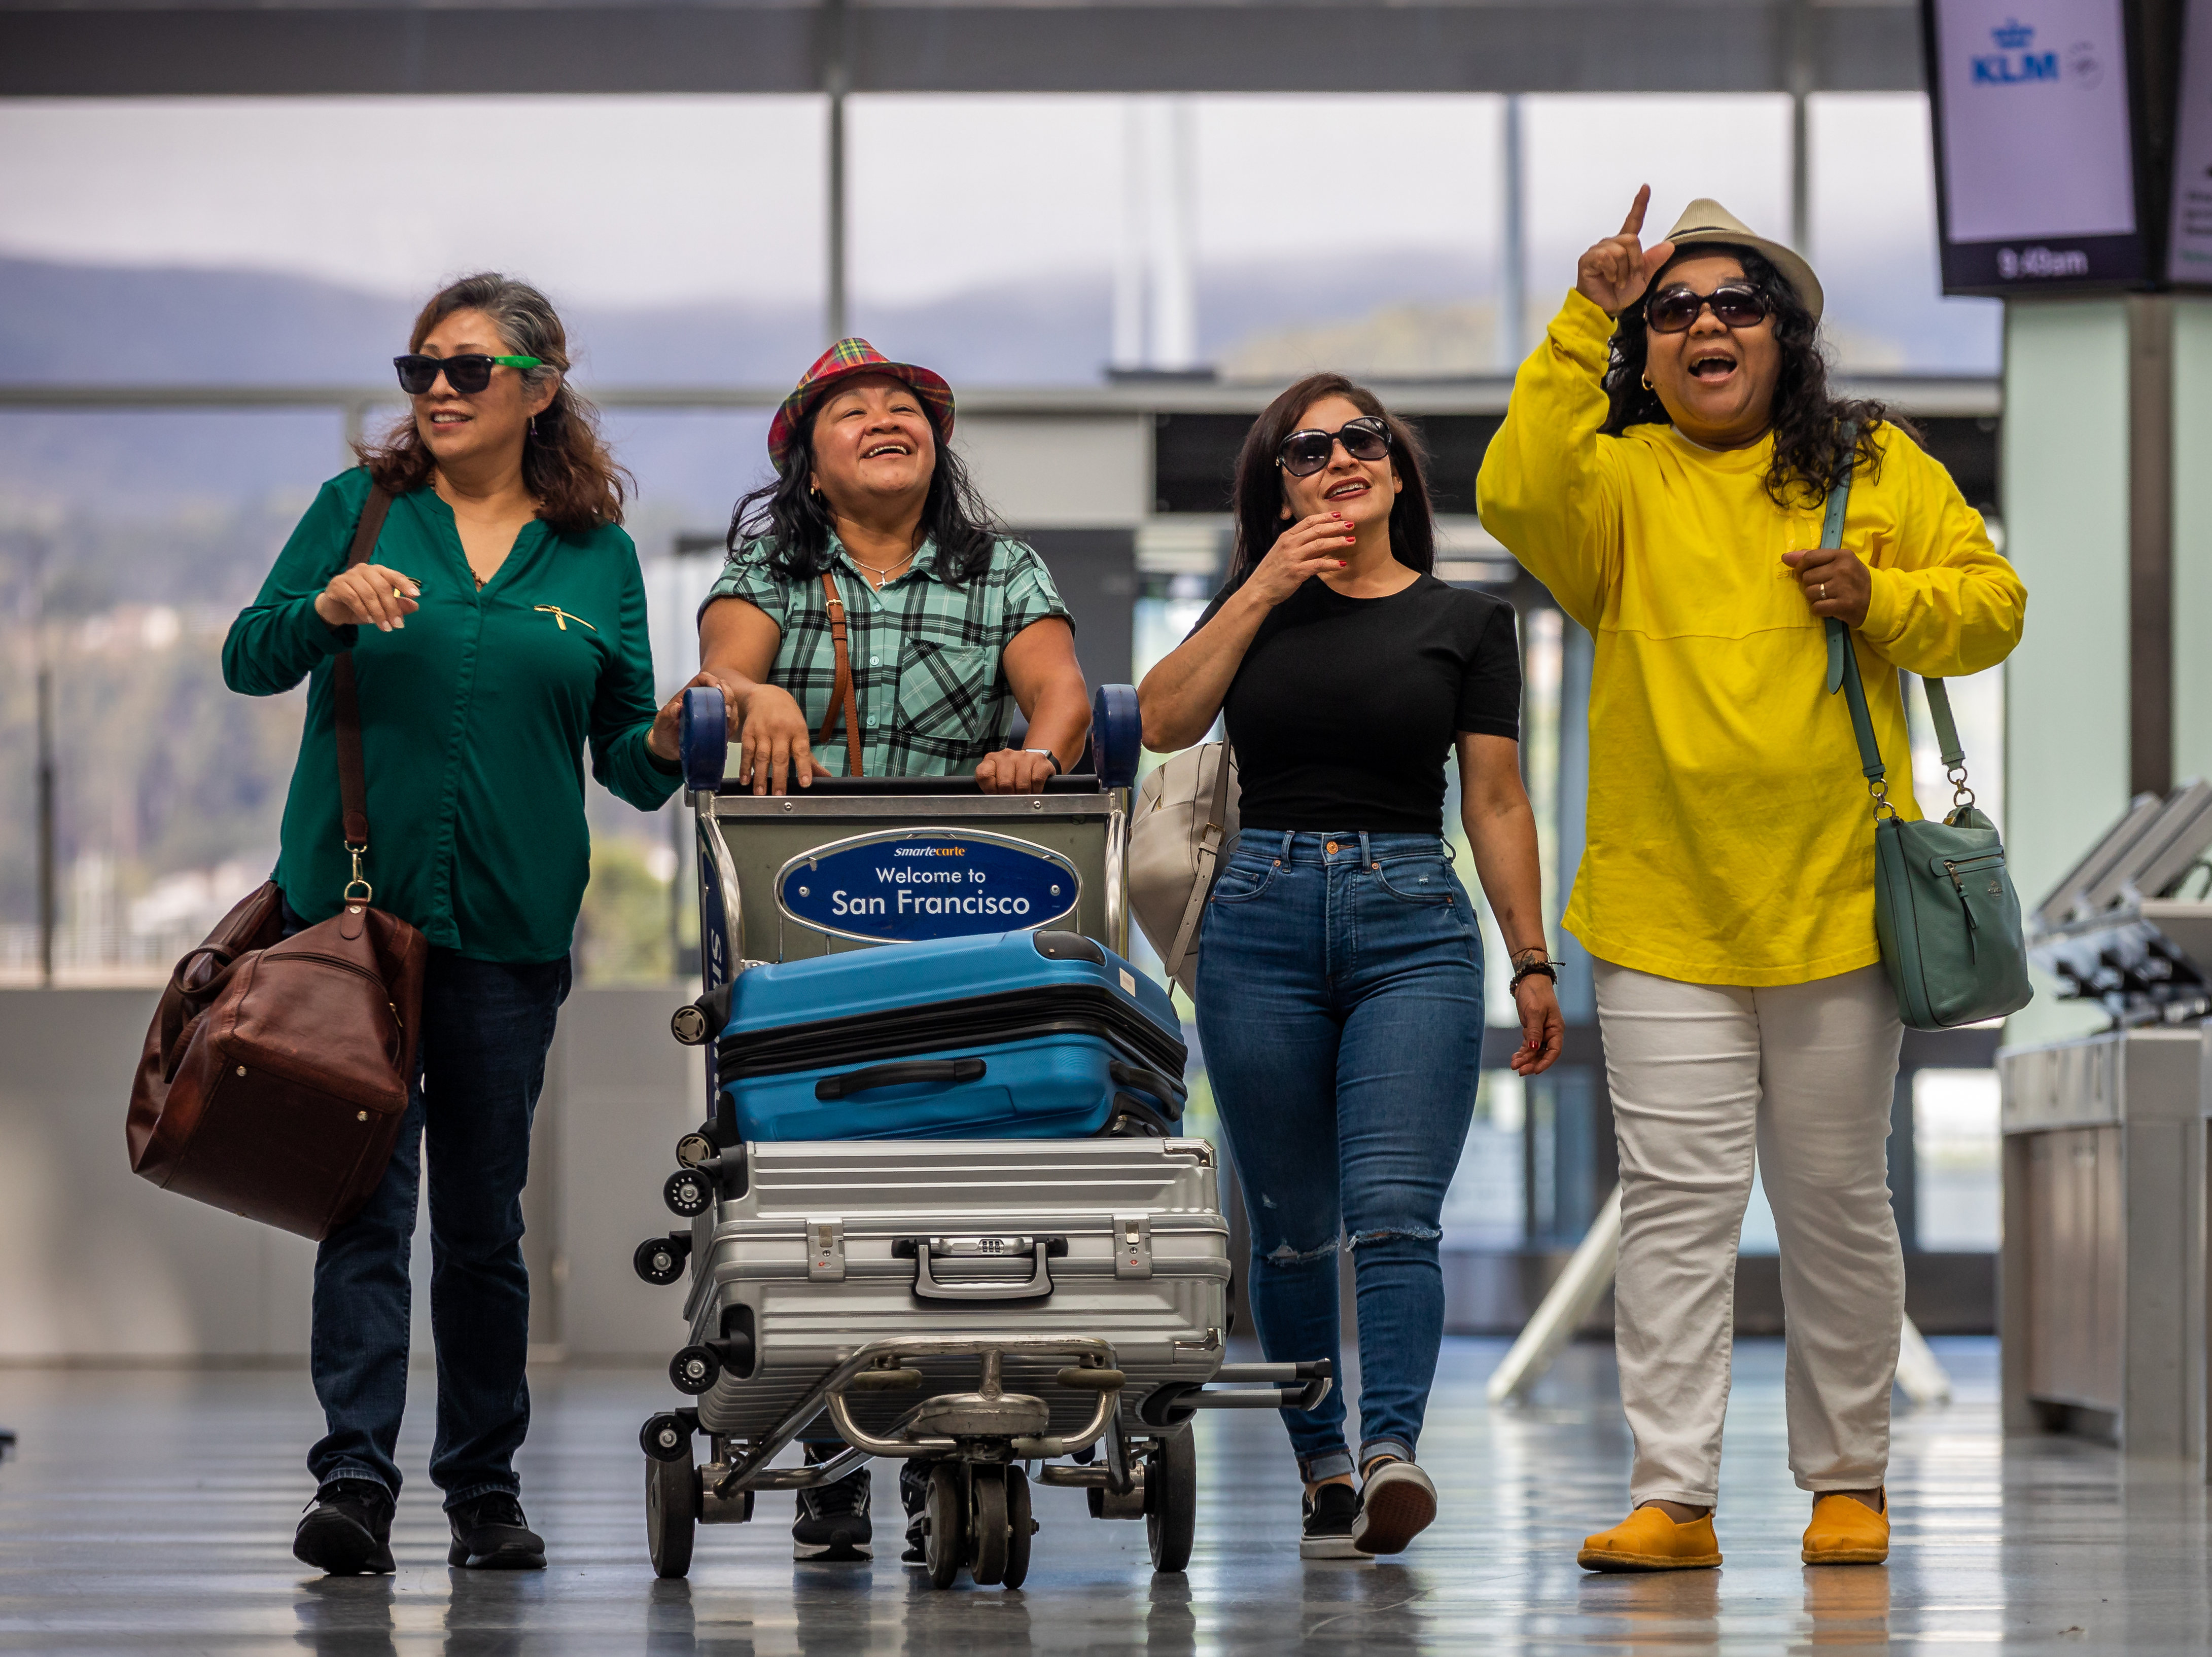
Provide an Outstanding
Guest Experience
2
7
7
Notes:
Goal 2, “Provide an Outstanding Guest Experience.”

Slide 8
Provide an Outstanding
Guest Experience
2.1 Achieve Airport Council International’s (ACI) highest level of customer (guest) experience accreditation.
2.2 Deliver the best-in-class facilities, programs, and services to attain global distinction and prominent recognition in the aviation, arts and culture, and hospitality industries.
2.3 Safeguard the health and well-being of all who travel through and work at SFO by improving our built environment.
2.4 Establish the Airport Integrated Operations Center (AIOC) as the North American benchmark for delivering a seamless guest journey.
2.5 Empower guests through innovative technologies to enable stress-free travel.
Supported by 14 initiatives
8
Notes:
This goal is based on the premise that all who journey through SFO are valued guests, elevating the quality of our interactions and infusing hospitality into the airport-guest relationship.
The objectives are about achieving the highest levels of customer experience, delivering best-in-class facilities, programs, and services, establishing the Airport Integrated Operations Center (AIOC) that will revolutionize the management of airport operations, and empowering our guests through innovative technologies.
Our goal is to raise the airport experience to unprecedented heights.

Slide 9
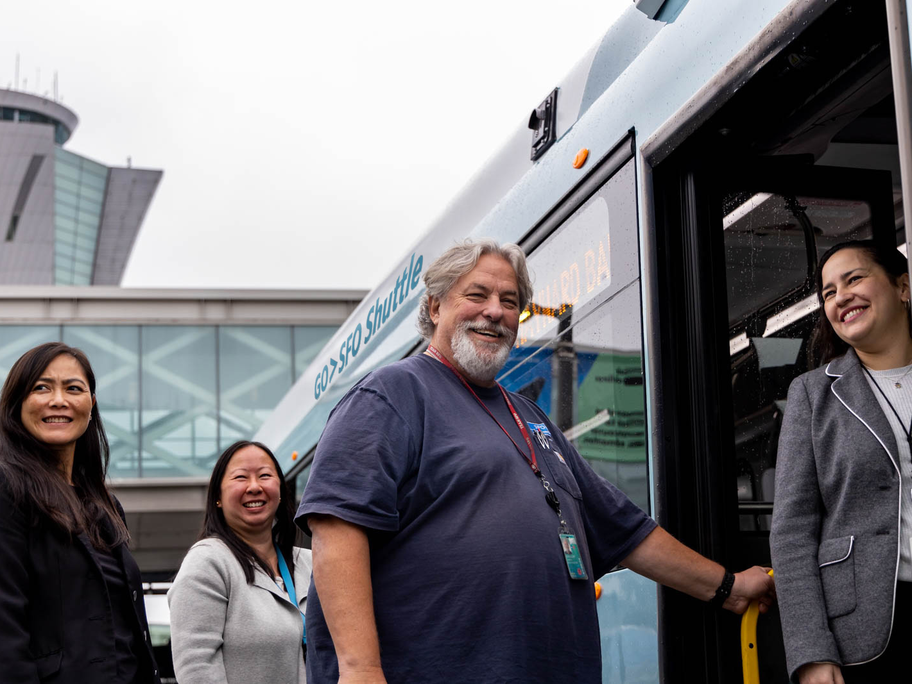
Elevate SFO Pride with an
Exceptional Employee Experience
3
9
Notes:
Goal 3, “Elevate SFO Pride with an Exceptional Employee Experience.”

Slide 10
Elevate SFO Pride with an
Exceptional Employee Experience
3.1 Strengthen workplace inclusion and belonging so that every employee feels respected, valued, and engaged to bring their personal best.
3.2 Invest in all employees by providing industry-leading career development resources and programs.
3.3 Provide equitable access to timely and open communication, build community, and deepen engagement by creating internal communication workflows.
3.4 Make SFO the best place to work by increasing options and access to employee well-being programs.
Supported by 14 initiatives
10
Notes:
SFO’s excellence is derived from the dedication, ingenuity, and creativity of our employees.
The objectives reflect an unwavering commitment to empower our team with an inclusive environment, resources that enable success, opportunities that foster growth, and access to the best well-being programs.
Our goal is an exceptional employee experience, recognizing that when our team is well-supported, they can perform at their best, ultimately enhancing the overall airport experience.

Slide 11
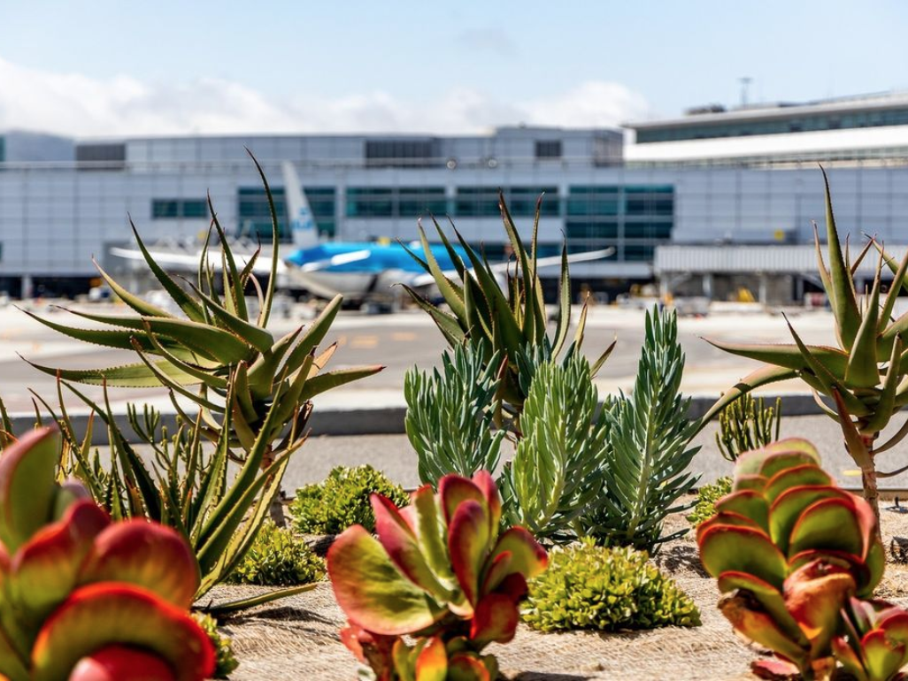
Take Bold
Climate Action
4
11
Notes:
Goal 4, “Take Bold Climate Action.”

Slide 12
Take Bold
Climate Action
4.1 Adopt a resilience capital plan and program to respond and rebound from geologic, climatic, and human-caused hazards, shocks, and stressors.
4.2 Inspire the public and industry partners to take bold climate actions.
4.3 Achieve net zero carbon for airport-controlled emissions by 2030 and establish a stakeholder emission reduction target and implementation plan by 2024.
4.4 Reach net zero energy by 2030 by accelerating distributed energy resources and electrical grid modernization and optimizing the performance of assets across their life cycle.
4.5 Become a zero-waste campus for airport-controlled municipal solid waste (MSW) and construction waste.
4.6 Be a net zero water campus by achieving balance between water consumption and measures that conserve, replenish, and recycle water by 2030.
Supported by 19 initiatives
12
Notes:
SFO’s longstanding leadership in environmental sustainability is embodied by its commitment to Zero - net zero carbon, net zero energy, and zero waste.
However, the urgency of the climate crisis compels SFO to push even further.
The goal “Take Bold Climate Action,” raises our aspirations with objectives and initiatives that further our climate leadership and demonstrate to the industry that restorative actions are possible today.
We also want to be a catalyst for change by connecting with our guests, suppliers, and neighbors to inspire their own climate advocacy.
All while recognizing that we must prepare and adapt to an uncertain climate future by ensuring the resilience of our assets and services.

Slide 13
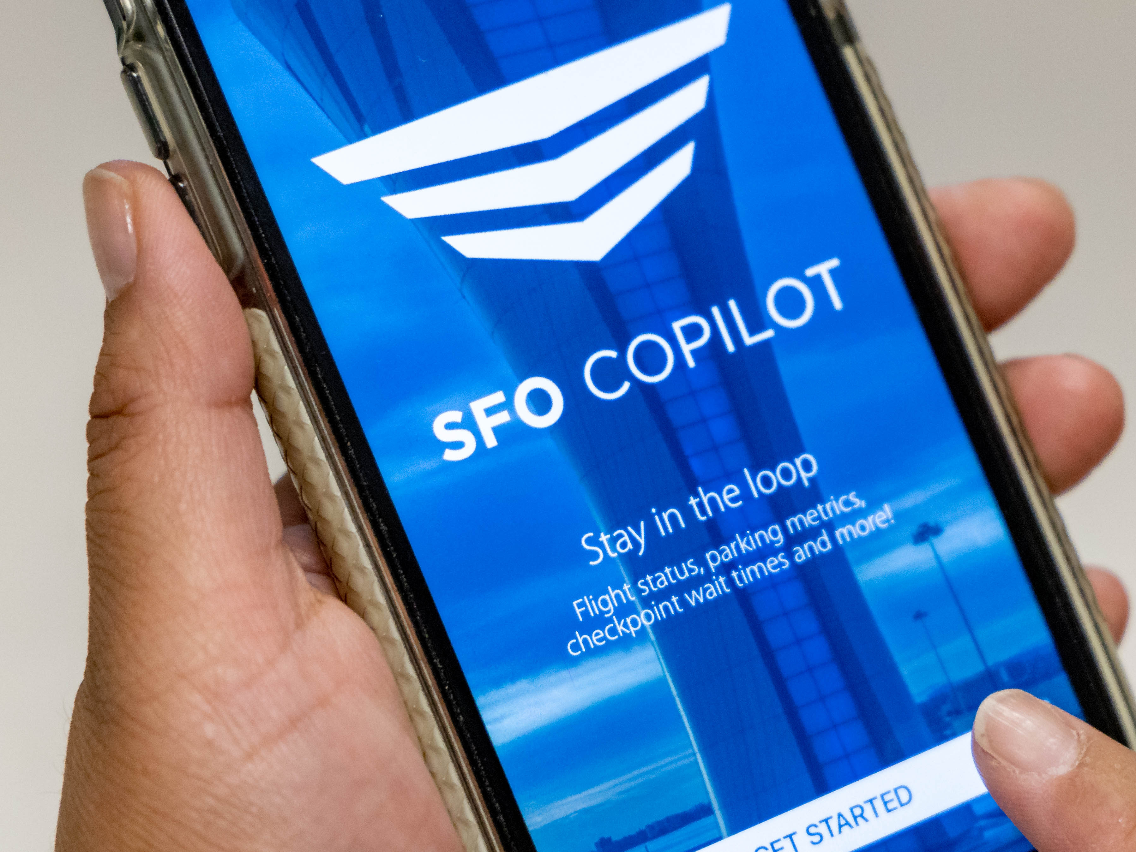
Ignite
Business Innovation
5
13
Notes:
Goal 5, “Ignite Business Innovation.”

Slide 14
Ignite
Business Innovation
5.1 Establish enterprise frameworks to enable innovations and stimulate new business opportunities.
5.2 Increase non-aeronautical revenue.
5.3 Acquire off-airport property investments and partnerships to diversify revenue and promote growth.
5.4 Increase the inclusion of historically underutilized businesses in construction, professional services, purchasing, and concessions.
Supported by 15 initiatives
14
Notes:
The objectives reflect our endeavor to foster entrepreneurship, technological innovations, and economic inclusivity.
We seek to elevate SFO services and amenities, bringing in new possibilities for guests and businesses alike.
By igniting innovation, the Airport not only aims to increase revenue but also uplift the local and small businesses that embody the rich diversity of our communities.
We will embark on this transformative journey of igniting business innovation, creating a thriving airport community that embraces progress, and empowering the ambitions of all who contribute to our shared success.

Slide 15
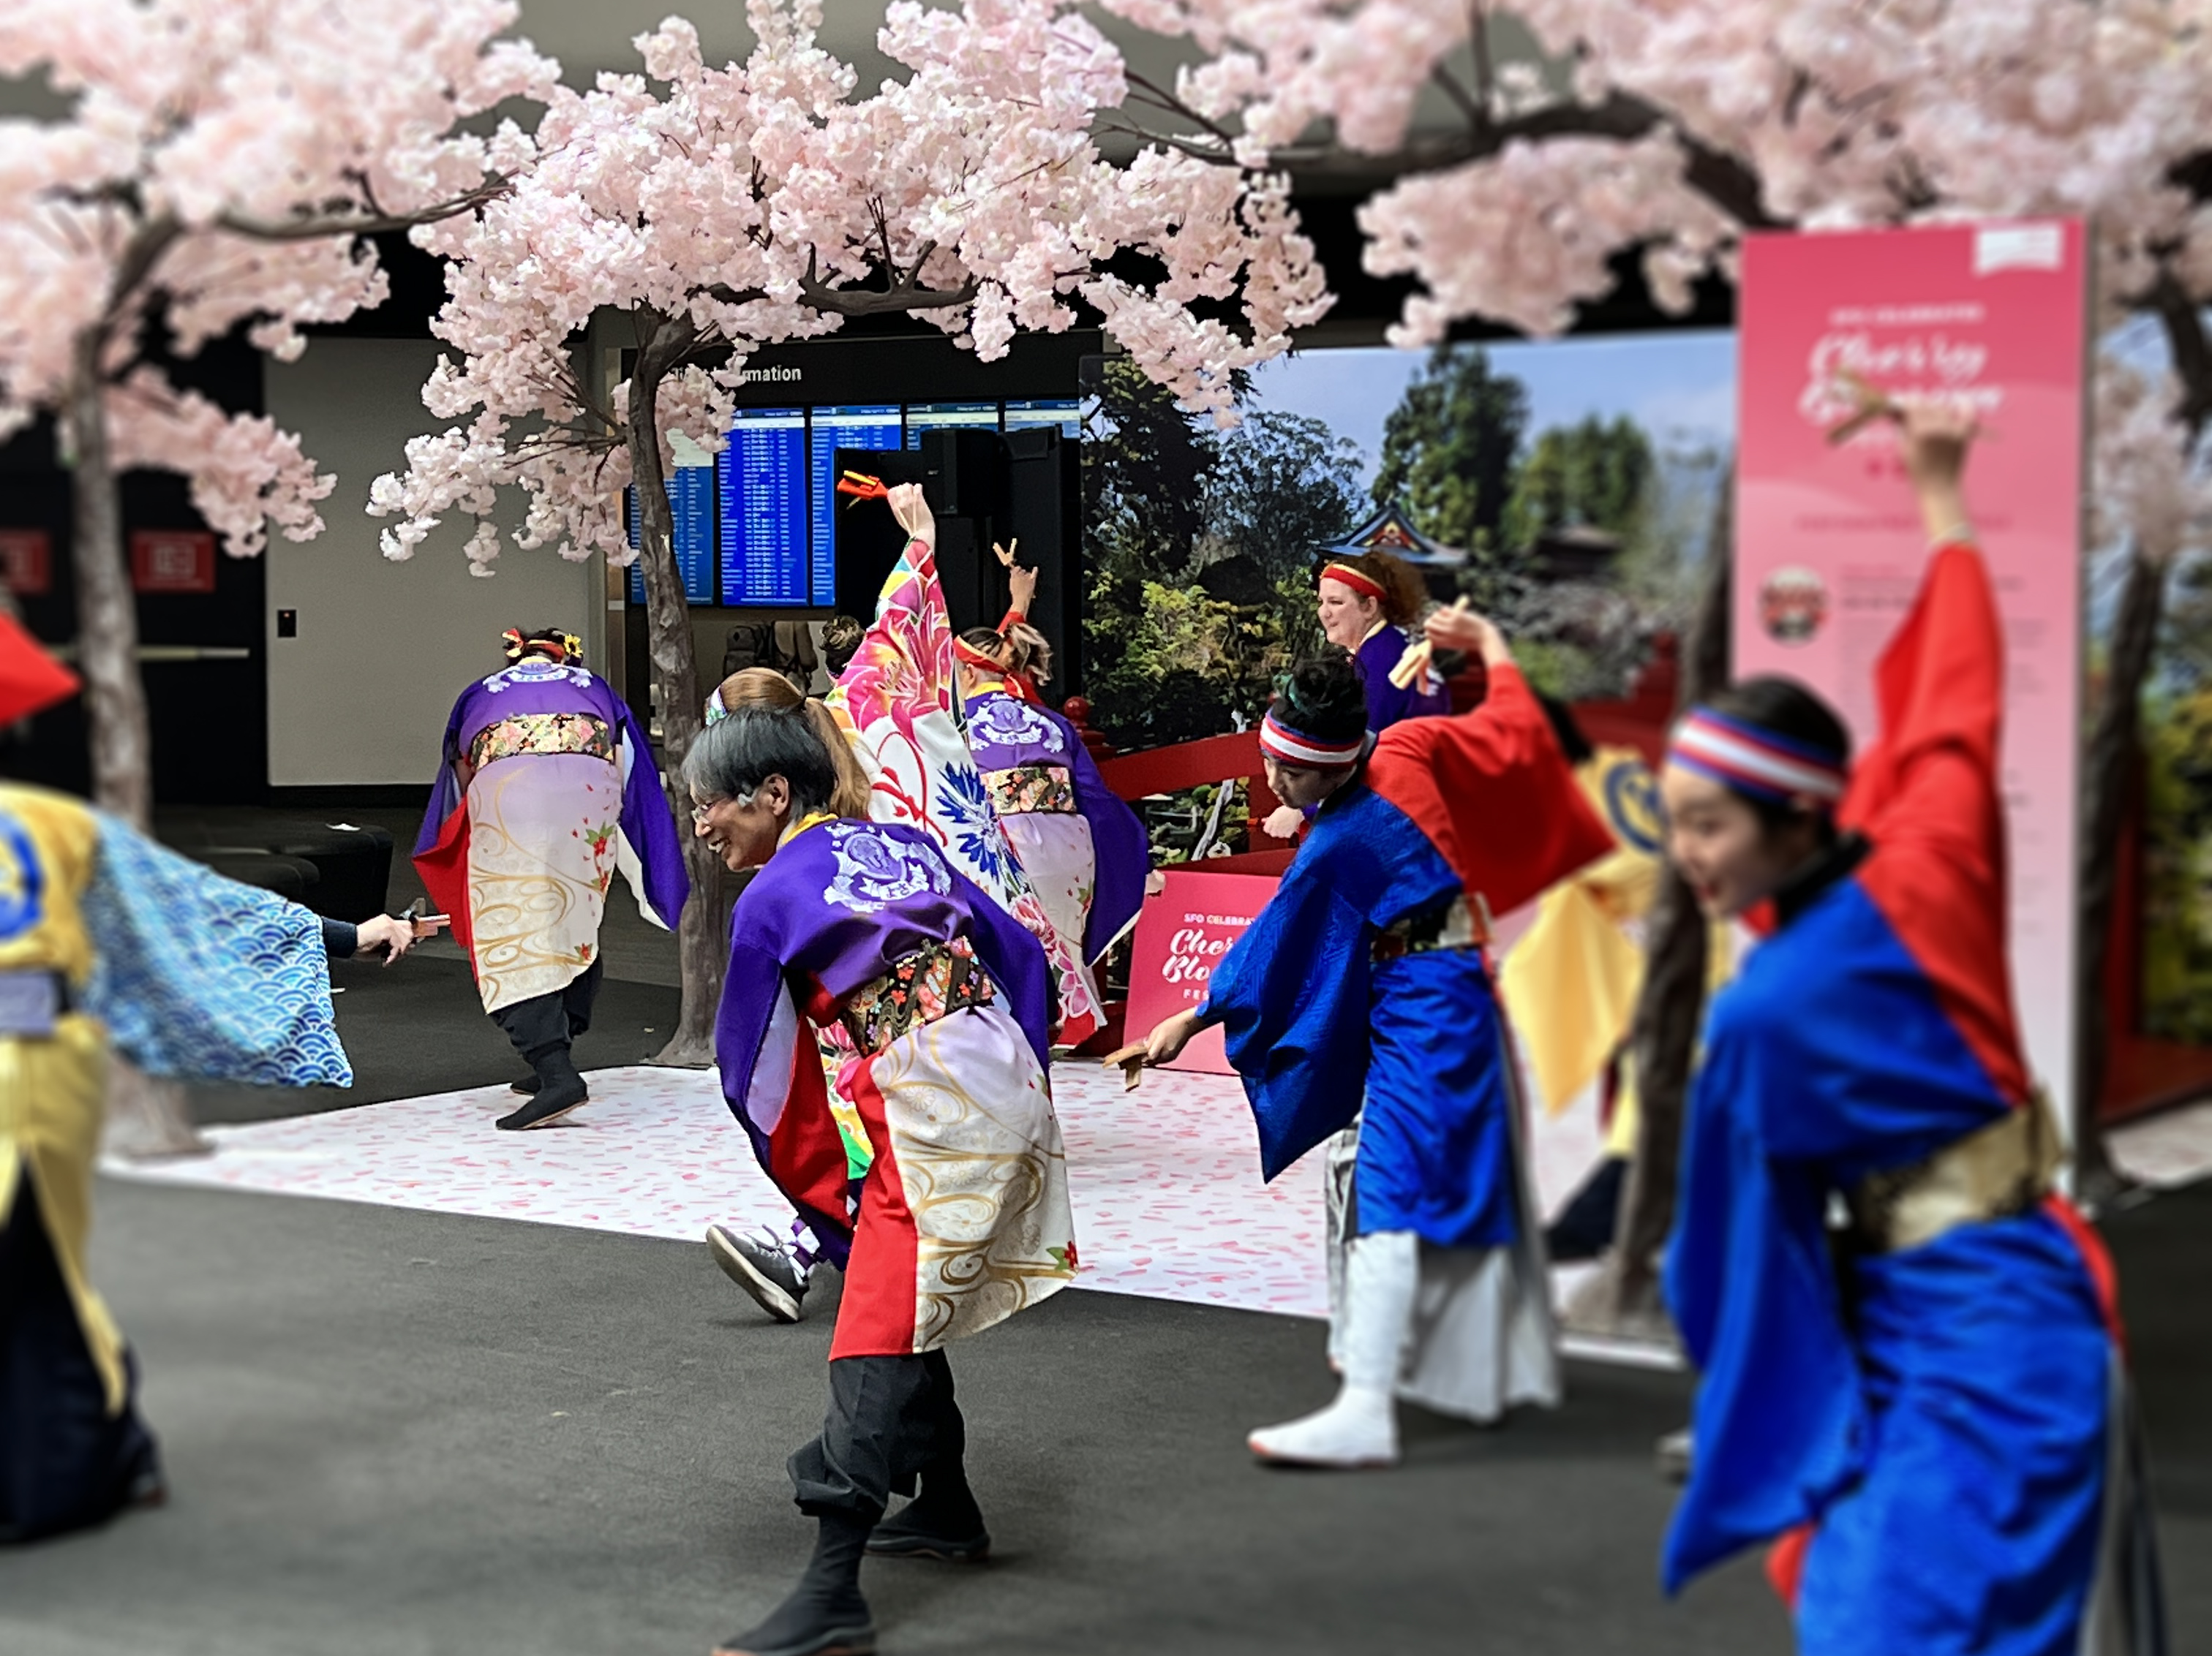
Achieve Social Impact
Through Partnerships
6
15
Notes:
Goal 6, “Achieve Social Impact through Partnerships.”

Slide 16
Achieve Social Impact
Through Partnerships
6.1 Expand workforce pipeline and development programs and educational partnerships to foster an inclusive approach in addressing the Airport’s evolving talent needs.
6.2 Partner with tenant employers to annually increase recruitment and retention of workers from underserved communities through equitable workforce development.
6.3 Establish SFO as the leading U.S. airport for cultural exchange.
Supported by 13 initiatives
16
Notes:
This goal embodies our commitment to partner with our communities to create enduring and positive social impacts.
Over the next five years, we will focus on creating educational opportunities, developing workforce pipelines and development programs, and promoting our City and region through art and cultural programs.

Slide 17
IMPLEMENTATION
Key Performance Indicator Development
Designated Initiative Division Champions
Capital Improvement Plan and Operating Budget Prioritization
Reaching for Extraordinary (R4E) Cross-Divisional Committees
Staff Performance Plans Aligned with Goals
17
Notes:
Now let's shift to the tangible ways we will implement the Strategic Plan to turn our vision into reality.
We will further develop Key Performance Indicators that track the six strategic goals.
Each of the 90 initiatives has a designated division champion responsible for guiding implementation. In alignment with Core Values, teams will collaborate cross-divisionally to ensure successful implementation.
The Strategic Plan guides SFO’s near-term financial planning efforts by prioritizing projects and programs included in the Capital Improvement Plan and the two-year operating budget.
The Reaching for Extraordinary (R4E) program will annually assemble cross-divisional committees to conceive and execute initiatives that align with and bolster the goals. R4E was formerly known as Reaching for Number 1 but was renamed to align with the new vision.
To cultivate a shared commitment across the airport, Staff performance plans will incorporate the Plan’s goals.
This implementation approach enables SFO to work collectively towards achieving the vision of “Inspiring the Extraordinary.”

Slide 18

Thank You
Thank You
Notes:
That concludes my presentation. I am happy to answer any questions.
NOTE: Thank you in 44 languages.
Source: (1) languages for which SFO Commission employees are certified; United States Census Bureau data about what languages San Franciscans speak at home; (3) Passenger traffic data from summer 2023 for those passengers who originated abroad with the official language of those countries, and (4) languages spoken by Strategic Plan Working Group members.

Slide 19





SUMMARY
Vision Inspiring the Extraordinary
Mission Delivery an Airport experience where people and our planet come first.
Core
Values
Safety & Security
Safety & Security
is our first priority.
TEAMWORK
We are one
team.
EXCELLENCE
Being your personal best makes our airport exceptional.
CARE
Promoting the well-being of our guests, our tenants, our community, and each other.
EQUITY
We are anti-racist, inclusive and respectful (AIR); committed to equitable outcomes for all.
Goals
1
Empower a Culture of Safety and Security Excellence
2
Provide an Outstanding Guest Experience
3
Elevate SFO Pride with an Exceptional Employee Experience
4
Take Bold Climate Action
5
Ignite Business Innovation
6
Achieve Social Impact through Partnerships
19
Supported by 26 Objectives and 90 initiatives
Notes:
Presented on this first slide are the high-level elements – the Vision, Mission, and Goals.
At the center of the plan are the mission and vision statements.
The vision, “Inspiring the Extraordinary,” is about a future where SFO sets new standards and achieves bold new heights not only for our benefit but to inspire change within our industry and to better our world.
The mission, "Delivering an airport experience where people and our planet come first," centers our purpose and everyday focus on people and our planet.
At the core of everything we do lies a deep commitment to the well-being of our guests, employees, tenants, and the communities we serve.
Likewise, environmental stewardship is our compass, guiding our decisions across our operations and projects.
The Strategic Plan also encompasses SFO’s Core Values of Safety & Security, Teamwork, Excellence, Care, and Equity.
They exemplify SFO’s culture, embodying how we work together, what we stand for, and guiding our decisions.
Staff performance appraisals include our core competencies which are focused on the Core Values, and training is offered to support ongoing development in those areas.
In addition, the annual Employee Recognition Awards honors team members whose work and contributions have supported the Core Values in an exceptional way.
The Core Values are foundational to who we are and are integral to the roadmap to the future established by the new 5-Year Strategic Plan.
Next, I will give a very brief overview of the 6 Strategic Plan goals.
To fulfill our mission and achieve our vision, we have developed six strategic goals to guide our efforts over the next five years.

Slide 20



MISSION
Delivering an airport experience
where people and our planet
come first.

Slide 21
VISION
Inspiring the
Extraordinary

Slide 22
SUMMARY
VISION
Inspiring the Extraordinary
MISSION
Delivering an airport experience
where people and our planet come first.
GOALS
Empower a Culture of Safety and Security Excellence
Provide an Outstanding Guest Experience
Elevate SFO Pride with an Exceptional Employee Experience
Take Bold Climate Action
Ignite Business Innovation
Achieve Social Impact Through Partnerships
22
Supported by 26 Objectives and 90 initiatives
Notes:
Presented on this first slide are the high-level elements – the Vision, Mission, and Goals.
At the center of the plan are new mission and vision statements.
The previous vision and mission statements had been in place since 2011.
While they have served us well over the past 12 years, the profound impact of the pandemic and the climate crisis compelled us to develop new statements better aligned with our purpose and aspirations.
The vision, “Inspiring the Extraordinary,” is about a future where SFO sets new standards and achieves bold new heights not only for our benefit but to inspire change within our industry and to better our world.
The mission, "Delivering an airport experience where people and our planet come first," centers our purpose and everyday focus on people and our planet.
At the core of everything we do lies a deep commitment to the well-being of our guests, employees, tenants, and the communities we serve.
Likewise, environmental stewardship is our compass, guiding our decisions across our operations and projects.
To fulfill our mission and achieve our vision, we have developed six strategic goals to guide our efforts over the next five years.

Slide 23
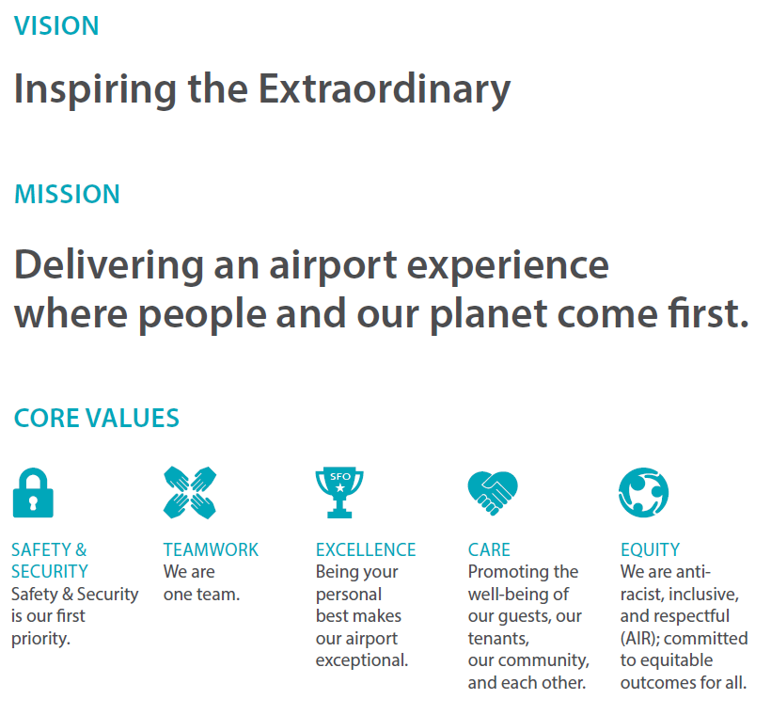
CORE VALUES
Safety
& Security
Teamwork
Excellence
Care
Equity
Safety & Security is our first priority.
We are one team.
Being your personal best makes our airport exceptional.
Promoting the well-being of our guests, our tenants, our community, and each other.
We are
anti-racist, inclusive, and respectful (AIR); committed to equitable outcomes
for all.
23
Supported by 26 Objectives and 90 initiatives
Notes:
The Strategic Plan also encompasses SFO’s Core Values of Safety & Security, Teamwork, Excellence, Care, and Equity.
Our values are enduring.
They exemplify SFO’s culture, embodying how we work together, what we stand for, and guiding our decisions.
Our Core Values are so fundamental to us that every new employee orientation starts with an introduction of the Core Values. Their meaning and importance are emphasized throughout the two-day orientation with discussions and activities.
Staff performance appraisals include our core competencies which are focused on the Core Values, and training is offered to support ongoing development in those areas.
In addition, the annual Employee Recognition Awards honors team members whose work and contributions have supported the Core Values in an exceptional way.
The Core Values are foundational to who we are and are integral to the roadmap to the future established by the new 5-Year Strategic Plan.

